Slide 1
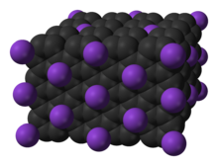
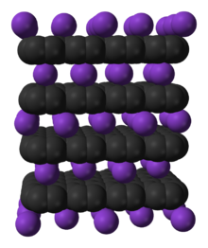
Graphite intercalation compounds

Slide 2
Graphitic/ Intercalation compounds
Graphite is perhaps the simplest substance with layered structure. The distance between the layers is large. Hence the sheets are held together by weak van der Waals forces. Many substances can be introduced in between the layers of graphite. The resulting compounds are known as intercalation compounds. Intercalation compounds consist of layers of different chemical species (similar to sandwiches) .
Graphite intercalation compounds (GICs) are complex materials having formula XC_{y} where element or molecule X is inserted (intercalated) between the graphite layers. When the host (graphite) and the guest X interact by charge transfer the in-plane electrical conductivity generally increases. In a graphite intercalation compound not every layer is necessarily occupied by guests. In stage 1 compounds, graphite layers and intercalated layers alternate and in stage 2 compounds, two graphite layers with no guest material in between alternate with an intercalated layer, likewise up to 5 stages are known. The actual composition may vary and therefore these compounds are an example of non-stoichiometric compounds.

Slide 3
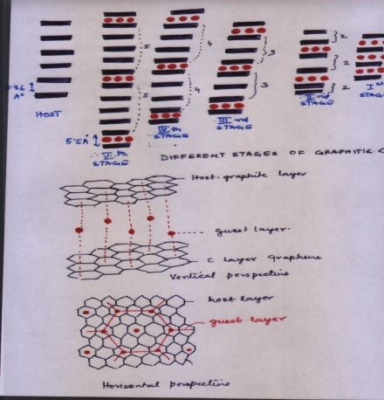

Slide 4
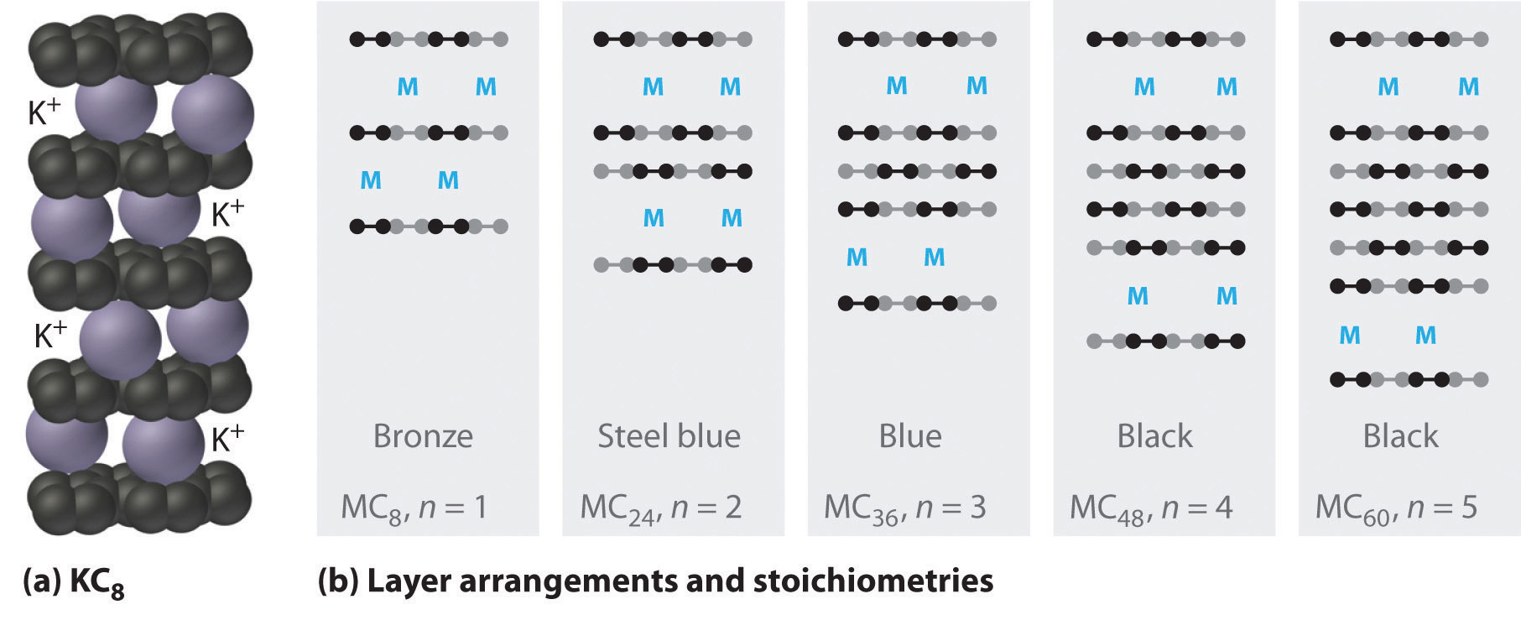
Graphite intercalation compounds

Slide 5
Graphite intercalation compounds
Potassium graphite
The longest known and the best studied graphite intercalated compound is with potassium when graphite is heated to about 300⁰ ^{C} with the vapours of heavier alkali metals like K, Rb, Cs, it absorbs the metal forming a bronze coloured first-stage compound with a limiting formula C₈M. The bronze colour is due to the formation of metal atom clusters at the high concentration of metal. Further intercalation cannot take place because of electrostatic repulsion.
C₈ K is paramagnetic. This implies that an electron from K atom to the π system of the graphite sheets is transferred. The alkali metal intercalate compounds of graphite are highly reactive. They may explode when puts into H₂O. They react vigorously in the air also.
If C₈ M is heated to 350^{0C} under reduced pressure, the metal is lost and a series of intercalation compounds are formed. The colour, composition and the number of layers invaded by the metal are given in the following table.

Slide 6
Graphite intercalation compounds
Composition | C₈ M | C₂₄ M | C₃₆ M | C₄₈M | C₆₀ M
Colour No. of layers Invaded | Bronze Every Layer | Steel blue Every Second Layer | Blue Every Third Layer | Black Every fourth Layer | Black Every fifth layer
The KC₈ form of potassium graphite is one of the strongest reducing agents known. Structurally, composition can be explained by assuming that the potassium to potassium distance is twice the distance between hexagons in the carbon framework. The bond between graphite and potassium atoms is ionic as graphite accepts electrons from Metals and the compound is more electrically conductive than α-graphite.

Slide 7
Graphite intercalation compounds
Carbon fluorides
Because of the valence bands and conduction bands having similar energies, graphite can either accept or donate electrons.
With Cl₂ and Br₂ , the bonding electrons from graphite are removed. This leaves a “positive hole” in graphite. The positive hole can migrate and therefore can carry current.
Carbon monofluoride is denoted as (CF)_{x} and used as a cathode material in one type of primary (non-rechargeable) lithium batteries. It is prepared by reaction of gaseous fluorine with graphitic carbon at 215–230 °C. The color is greyish, white, or yellow. The bond between the carbon and fluorine atoms is covalent. The compound is not electrically conductive which makes the addition of conductive fillers necessary for battery use.

Slide 8
Graphite intercalation compounds
Graphite oxide or graphitic oxide -
These compounds are formed between O and F with graphite. These compounds are non conductors. Graphite oxide or graphitic oxide is a non-stoichiometric substance formed by the action of strong oxidizing agents like concentrated NHO₃; HClO₄ with graphite. It is an unstable, pale lemon coloured substance that decomposes slowly at 70⁰C.
The interlayer's spacing increases in the oxide to 6-7 Å . In the oxide all four electrons on a carbon atom are involved in bonding . Thus the mobile π-electrons found in graphite may cease to be delocalized. This explain the non conductivity of electricity of these compounds.

