Slide 1
Spectral properties
Colour of Transition metal complexes
A substance exhibit colour because it has property of absorbing certain radiation from visible range and radiates the complimentary colour of absorbed light. In transition metal complexes the energy difference between two sets of d- orbitals is small. Thus an electronic transition between low energy d- orbital (t_{2g} to e_{g} in octahedral complexes and e_{g} to t_{2g} in tetrahedral complexes) can easily be achieved by absorbing low energy radiations and reflect them also in visible range of spectrum.
The d-d transitions depend on –
oxidation state of the metal
No. of ligands
Nature of ligands
Geometry of the comples

Slide 2
Colour of Transition metal complexes
If λ is wave length of radiation absorbed, its energy E = hc/ λ , where c = velocity of light, h = Planck’s constant. For example [Ti(H₂O)₆]^{+.}
Ti has d¹configuration and single electron occupies t_{2g} orbital. When light energy is passed thru its solution it absorbs green light at approx. wave length of 5000 A and electron goes to high energy e_{g} orbital . This is d-d transition.
As per the above formula the energy is found to be 240 Kj/mole. This enegy is equivalent to Crystal field splitting energy Δº, the energy required to promote electron to e_{g} level and bring about d-d transition.
Since green – yellow light is absorbed, violet – purple light is reflected.

Slide 3
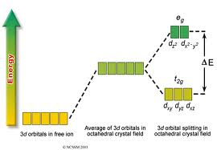
Colour of Transition metal complexes
Green
Violet
[Ti(H₂O)₆]⁺
d – d transition

Slide 4
Spectral properties
Wave length in A⁰
3000
4000
5000
Charge transfer peak
With the hef visible spectra it is possibl to predict the colour of the complex. From the plot of absorbance vs frequency, absorbance maxima is at wave length 5000 A⁰ = wave no. 20,300 cm -1
Energy associated with wave no. 20,300
= 240 Kj/mole
This is equal to Δº between t_{2g} to e_{g}
Absorbance
30000
20000
10000
Frequency in wave no.
Since the difference in energy levels between t_{2g} to e_{g} vary with the nature of metal ion, the ligand and the geometry , complexes absorb in radiations from different regions of the visible band and hence give different colour.

Slide 5
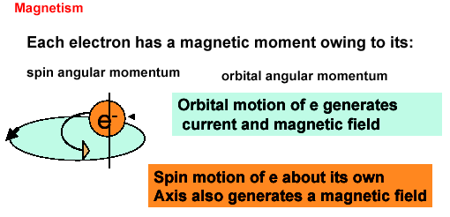
Magnetic behaviour
Magnetic behaviour of any material depends on the presence /absence of unpaired electron.

Slide 6
Electron is a micro magnet that moves
On its axis – Spin moment
In the orbitals – Orbital moment
Total magnetic moment = Spin moment + Orbital moment
µ_{(S + L)} = √4S (S+1) + L( L + 1)
Magnetic moment can be obtained by Gouy’s balance and calculated as
E = h/4 π mc B.M.

Slide 7
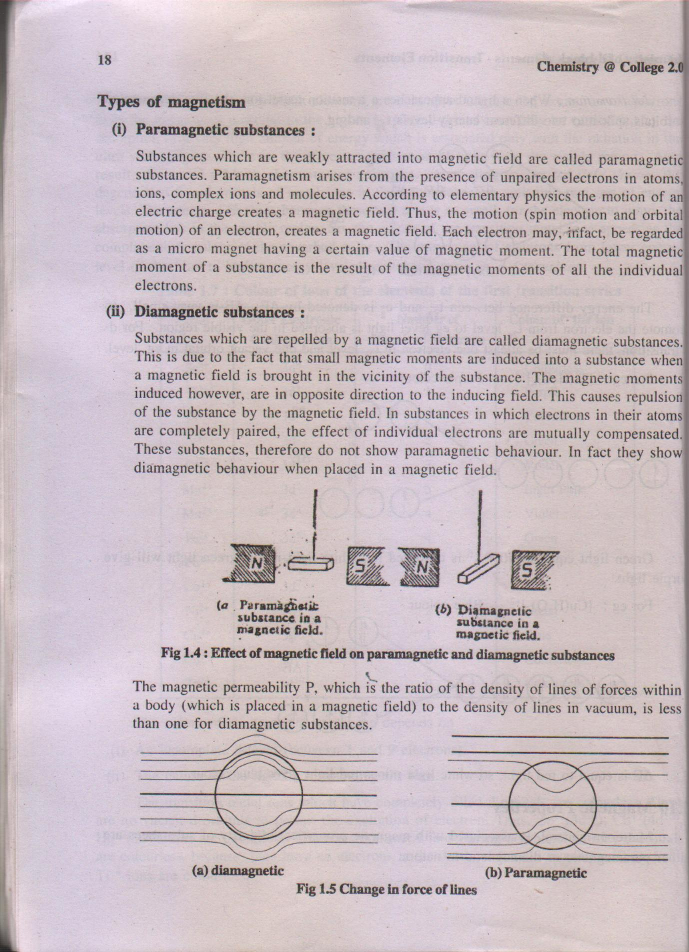

Slide 8
