Slide 1
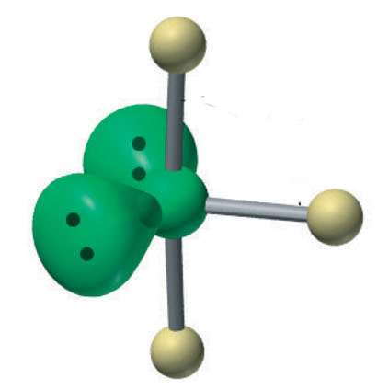
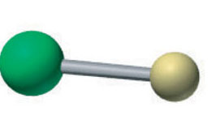
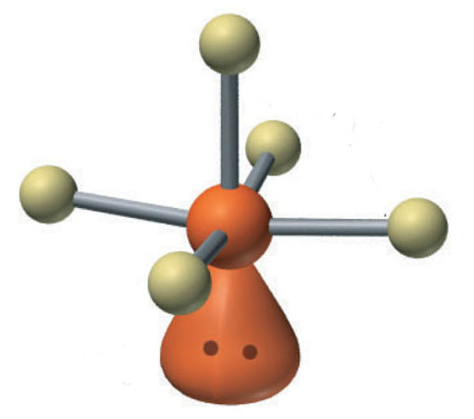
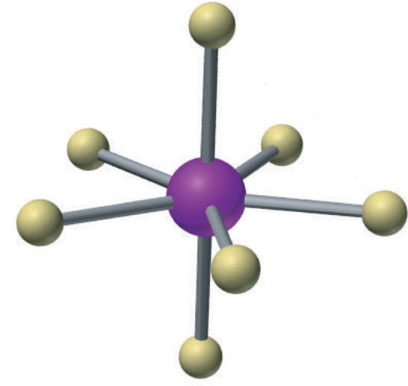
Molecular shapes of the main types of interhalogen compounds
88⁰
ClF
ClF₃
linear, XY
T-shaped, XY₃
BrF₅
86⁰
IF₇
90⁰
Pentagonal bipyramidal, XY₇
Square pyramidal, XY₅

