Slide 1
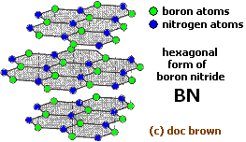
Boron Nitride - Inorganic graphite

Slide 2
Boron Nitride - Inorganic graphite
-
Boron nitride is a chemical compound with chemical formula BN, consisting of equal numbers of boron and nitrogen atoms. BN is isoelectronic to a similarly structured carbon lattice and thus exists in various crystalline forms. The hexagonal form corresponding to graphite is the most stable and softest among BN polymorphs, and is therefore used as a lubricant and an additive to cosmetic products. The cubic variety analogous to diamond is called c-BN.
Boron nitride is not found in nature and is therefore produced synthetically from boric acid or boron trioxide. The initial product is amorphous BN powder, which is converted to crystalline h-BN by heating in nitrogen flow at temperatures above 1500 °C.
Because of excellent thermal and chemical stability, boron nitride ceramics are traditionally used as parts of high-temperature equipment. Boron nitride has a great potential in nanotechnology. Nanotubes of BN can be produced that have a structure similar to that of carbon nanotubes, a BN nanotube is an electrical insulator . Similar to other BN forms, BN nanotubes are more thermally and chemically stable than carbon nanotubes which favors them for some applications.

Slide 3
Boron nitride (BN)_{n}
It’s a polymer of boron & nitrogen. Similar to graphite C_{n} & also iso electronic to it.
Both B and N undergo sp² hybridisation. The hybrid orbitals of B & N overlap to form σ bonds while the remaining electrons from π-bonds
The structure is similar to graphite C_{n} but the π– electrons are partially delocalized over B-atoms leading to unequal (B-N) bond lengths
Each hexagonal ring has alternate single & double bonds with three boron and three nitrogen atoms
The layers are so arranged that boron atom of one layer is immediately over the nitrogen atom of the adjacent layer
B-N bonds length is 1.45 A⁰ while the distance between any two layers is 8.33A⁰
Boron nitride when heated to 3000⁰ at 70,000 atom pressure gives a cubic form like diamond structure where B & N attains a tetrahedral coordination. The (BN)_{n} in this form is superior to diamond in its mechanical strength & hardness but easily undergoes surface oxidation.

Slide 4
Preparation of Boron nitride
1. By heating boron in nitrogen, NO or NH₃
2B+N₂ → 2BN
5B+3NO→ 3BN + B₂O₃
2B +2NH₃ → 2BN +3H₂
2. By heating B₂O₃ with Hg(CN)₂ KCN or NH₄Cl
B₂O₃+2 KCN → 2BN +K₂O+2CO
3. Anhydrous borax is heated with dry NH₄Cl to red heat in a platinum crucible
Na₂B₄O₇ + 2NH₄Cl → 2BN +2Na Cl + B₂O₃ +4H₂O
4. B₂H₆ reacts with excess of NH₃ at high temp, BN is obtained
B₂H₆+2NH₃ → 2BN+6H₂
Properties
It gets decomposed when heated in steam, evolving NH₃

Slide 5
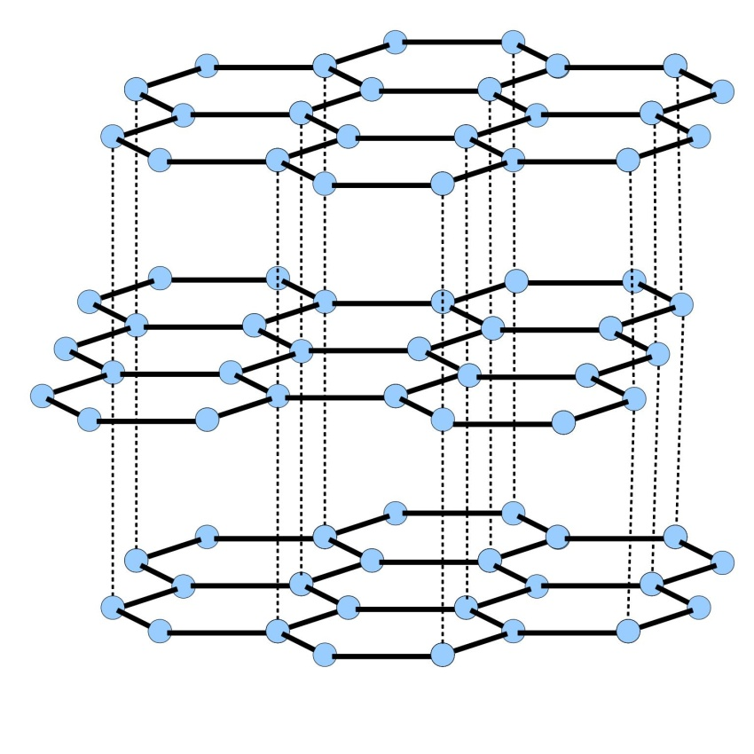
BORON NITRIDE
GRAPHITE

